Slide 1

WELCOME TO OUR CLASS

Slide 2


Slide 3

Ex1 (p.56). Label the things in nature you can see

Slide 4
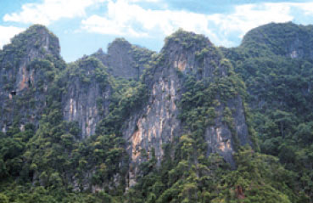
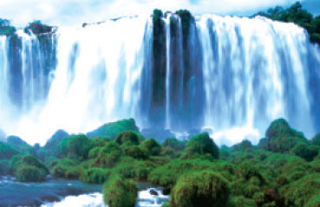
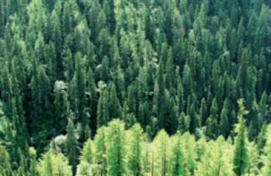
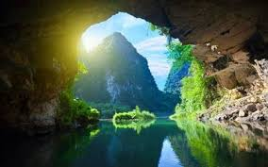
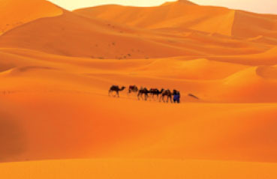
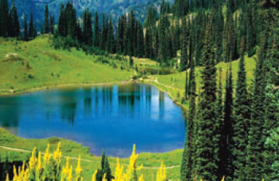
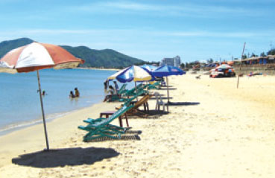
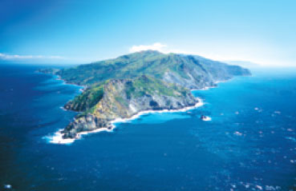
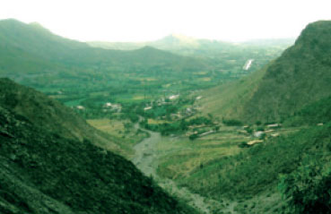
Ex1 (p.56). Label the things in nature you can see
1
2
3
4
5
6
7
8
9

Slide 5
Ex1 (p.56). Label the things in nature you can see
1
2
3
4
5
6
7
8
9

Slide 6
Ex1 (p.56). Label the things in nature you can see
1
2
3
mountain
waterfall
forest
4
5
6
cave
desert
lake
7
8
9
beach
island
valley

Slide 7
Ex 4 (p.56). Match the name of a natural wonder in A with a word/phrase in B
A
ANSWER
B
1. Everest
mountain
a. bay
2. Loch Lomond
freshwater lake
b. desert
3. Ha Long
bay
c. freshwater lake
4. Ayers
rock
d. mountain
5. The Sahara
desert
e. rock

Slide 8
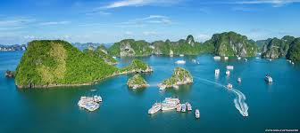
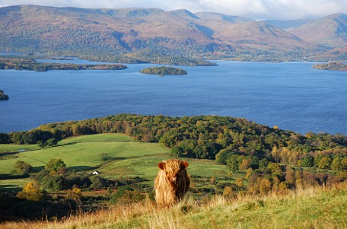
5 (p.56). Work in pairs. Ask and answer about the natural wonders
Model dialogue
A: What is Ha Long?
B: It is the nicest bay in the world.
It’s in Quang Ninh province, Viet Nam.
A: What is Loch Lomond?
B: I don’t know. Do you know it?
A: Yes, it is the largest lake in Great Britain.
(or: No, I don’t)
Ha Long bay
Loch Lomond freshwater lake

Slide 9
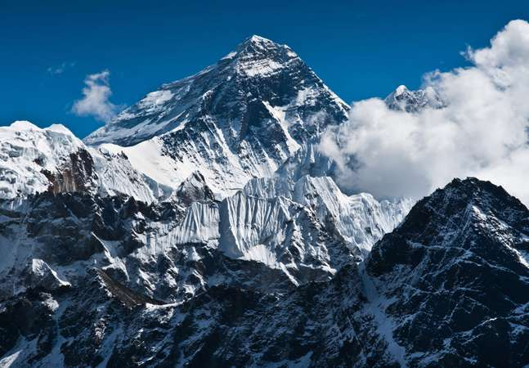
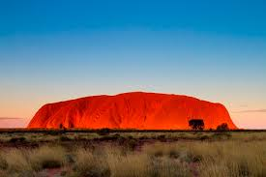
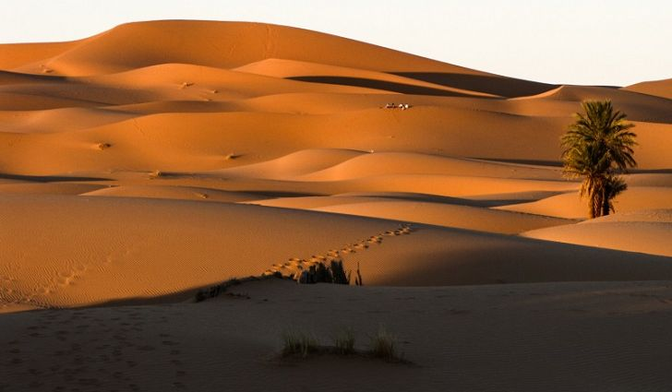
5 (p.56). Work in pairs. Ask and answer about the natural wonders
Everest mountain
Ha Long bay
Ayers rock
Sahara desert
Loch Lomond freshwater lake

Slide 10
Ex3 (P. 56) Fill the gaps in the following sentences
1. Everest mount is ……….….(high) mountain in the world.
2. Loch Lomond is …...……(large) freshwater lake in Great Britain.
3. Ayers rock is …….…..(nice) rock in Australia.
4. The Sahara desert is .….………(hot) desert in the world.
5. Ha Long is …..……(good) place for tourists to come.
the highest
the largest
the nicest
the hottest
the best

Slide 12

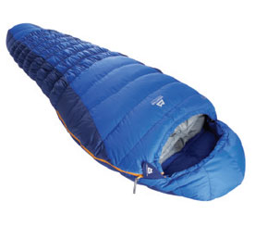
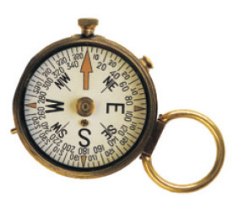
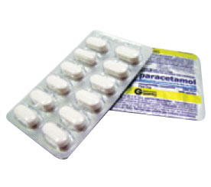
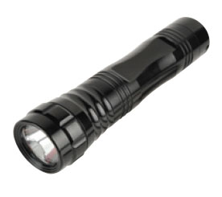
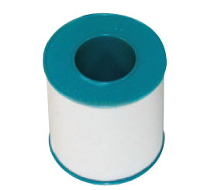
Ex2 (p.56). Write the words (travel items)
1
2
3
4
5
6

Slide 13
Ex2 (p.56). Write the words (travel items)
1
2
3
4
5
6

Slide 14
Ex2 (p.56). Write the words (travel items)
1
2
3
scissors
sleeping bag
compass
4
5
6
torch
painkillers
plaster

Slide 15

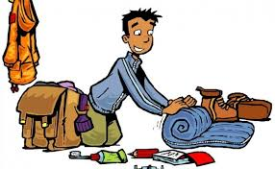
You must take/do….… It is …….
You mustn’t take/do……. It’s.…..
You must take/do….… It is …….
You mustn’t take/do……. It’s.…..
A
B

Slide 16
Ex6 (p.56): Complete the dialogue.
A want to go to Everest mountain.
B gives A advice using “must”/”mustn’t”.
A: I want to go to Everest mountain!
B: It’s dangerous to go hiking there. You (1)……………… tell someone where you are going. You (2)..………..……go alone.
A: Yes, and I (2)…….…..…. take a warm coat. It is very cold there.
B: Yes, and you (3) …….………take a mobile phone. It’s very important.
A: OK, and I (4)….……..…take all necessary things along with me.

Slide 17
Ex6 (p.56): Complete the dialogue.
A want to go to Everest mountain
B gives A advice using “must”/”mustn’t”.
A: I want to go to Everest mountain!
B: It’s dangerous to go hiking there. You (1)……………… tell someone where you are going. You (2)..………..…… go alone.
A: Yes, and I (2)…….…..…. take a warm coat. It is very cold there.
B: Yes, and you (3) …….………take a mobile phone. It’s very important.
A: OK, and I (4) ….……..…take all necessary things along with me.
must
mustn’t
must
must
must

Slide 18
Work in pairs to:
tell about the place you want to go.
give your friends advice, using “must” and “mustn’t”.
You must take/do….… It is …….
You mustn’t take/do……. It’s.…..
You must take/do….… It is …….
You mustn’t take/do……. It’s.…..
A
B

Slide 20
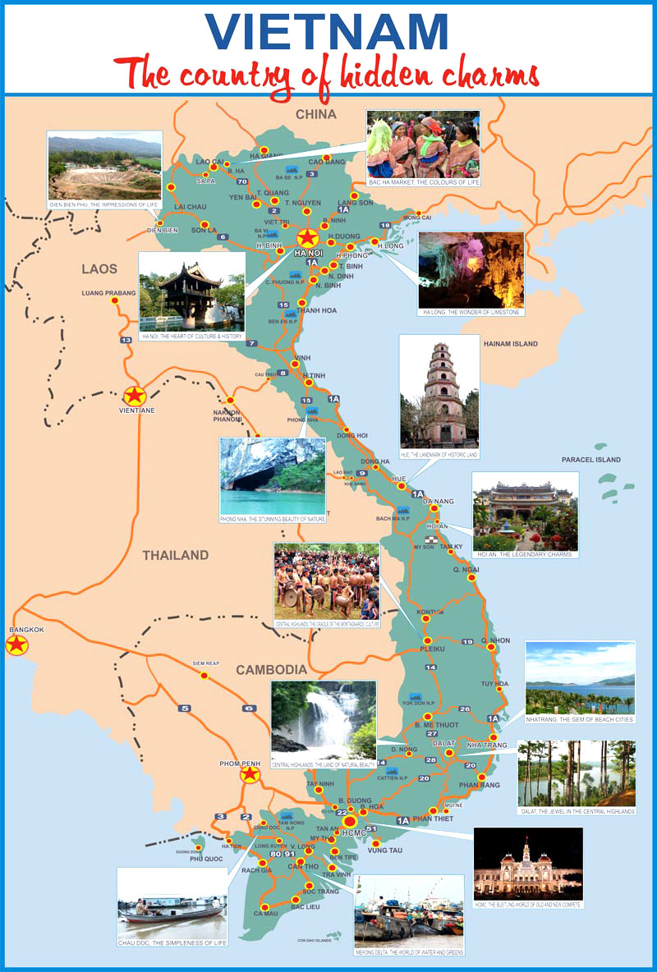
How well do you know about Viet Nam?
Natural
Natural attraction
What’s / high / mountain in Viet Nam?
What’s / long / river?
…..…
Weather
What’s / wet / place in Viet Nam?
What’s /hot / place?
…..…
Travelling
What’s nice / city in Viet Nam?
What’s /good places/ for tourists
to come? ........

Slide 21
How well do you know about Viet Nam?
Information
???
Communication and interaction
???
Vocabulary and grammar
???

Slide 23


Slide 24


Natural attraction
Team 1
What’s/high/mountain/Viet Nam?
2. What’s/long/river?
What’s/big/island?
What’s/large/lake?
Tour guides: Thùy Dương, Bảo Châu, Cảnh Tùng,
Phương Linh, Châu Khang

Slide 25
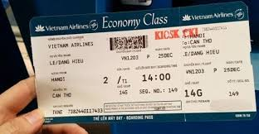
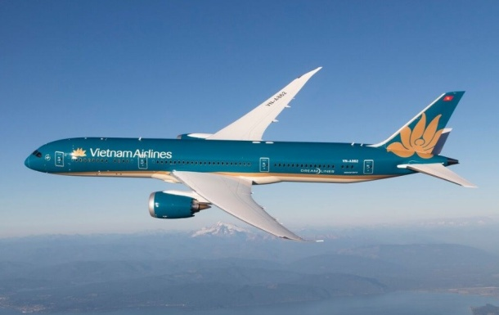
How well do you know about natural attraction in Viet Nam?
Raise your hands up when you have the answer. The quicker one will have right to answer first.
If the answer is not correct, the others will take turn to answer
One Vietnam airlines ticket for one correct answer.

Slide 26
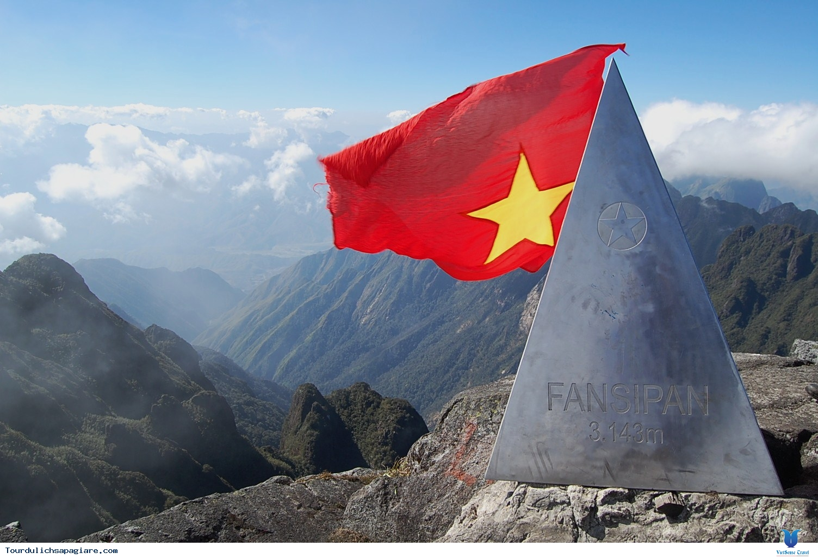
- What's the highest mountain in Viet Nam?
It’s Fansipan mountain in Lao Cai
Height: 3143 metres

Slide 27
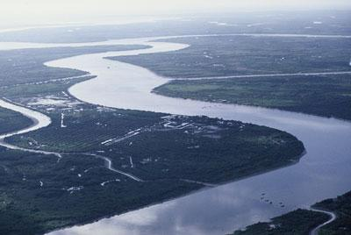
- What's the longest river in Viet Nam?
It’s Mekong River in the South of Viet Nam
Length: about 4.200km. Starting point: China
Tien Giang: 220km – Hau Giang: 250km

Slide 28
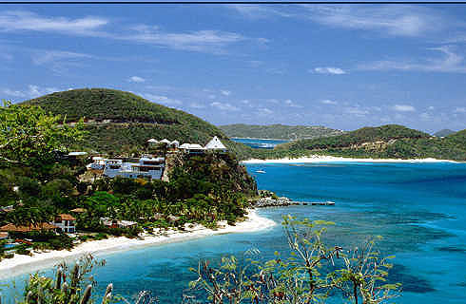
- What's the biggest island in Viet Nam?
- It’s Phu Quoc island in Kien Giang province
Area: about 600 km2

Slide 29
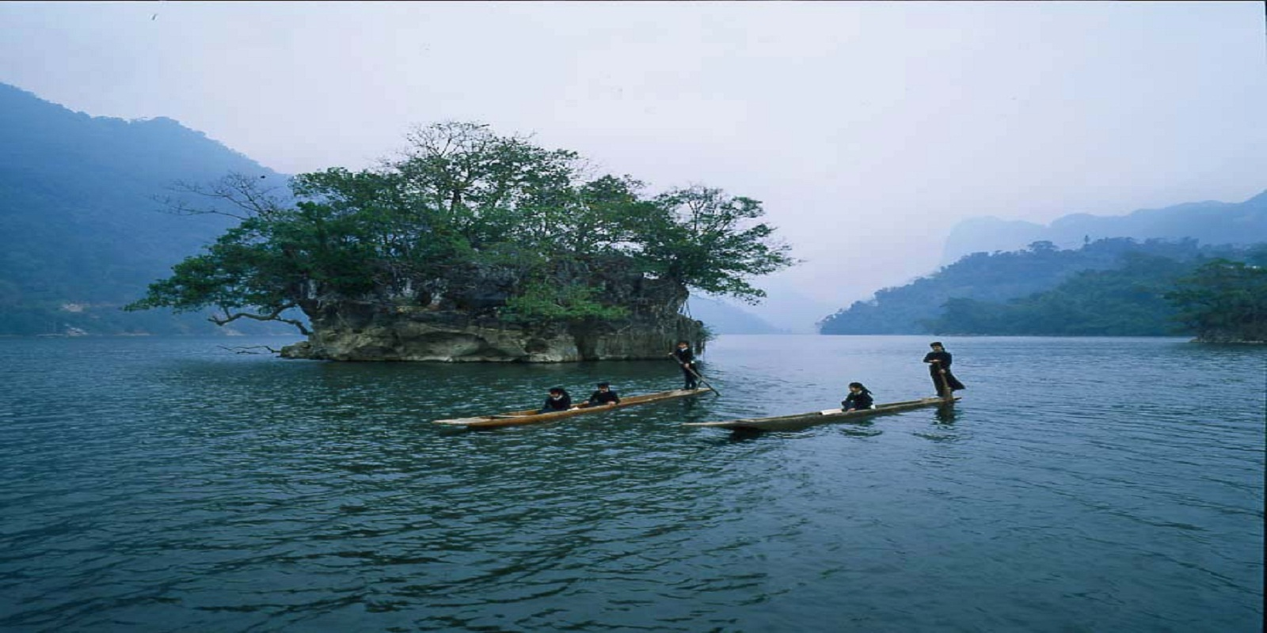
- What's the largest lake in Viet Nam?
It’s Ba Be Lake in Bac Kan province
Length: 8km
Surface area: 6,5km2

Slide 30


Slide 32

Tour guides: Quản Ngọc Minh, Nguyễn Ngọc Minh, Hải Minh, Minh Anh, Gia Hưng, Anh Thư
How well do you know Viet Nam ? Group 2

Slide 33
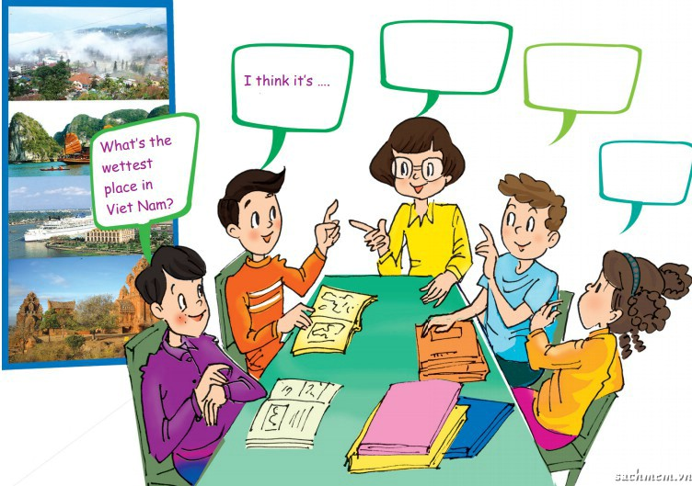
1. What’s/wet/place in Viet Nam?
2. What’s/hot/ place?
3. What’s/cool/ place?
4. What’s/cold/ place?

Slide 34

Quiz: How well do you know about the weather in Viet Nam?
Work in group of 5
Discuss about the questions then write down your answer on the answer sheet.
If you have a correct answer, you will get one voucher for the next trip.

Slide 35

1. What’s the wettest place in Viet Nam?
Weather

Slide 36
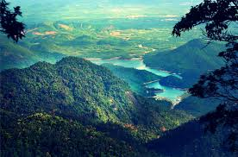
- The wettest place in Viet Nam is National forest Bach Ma in Thua Thien Hue
Weather
(Average rainfall in the top of the mountain: 800ml)

Slide 37

2. What’s the hottest place in Viet Nam?
Weather

Slide 38
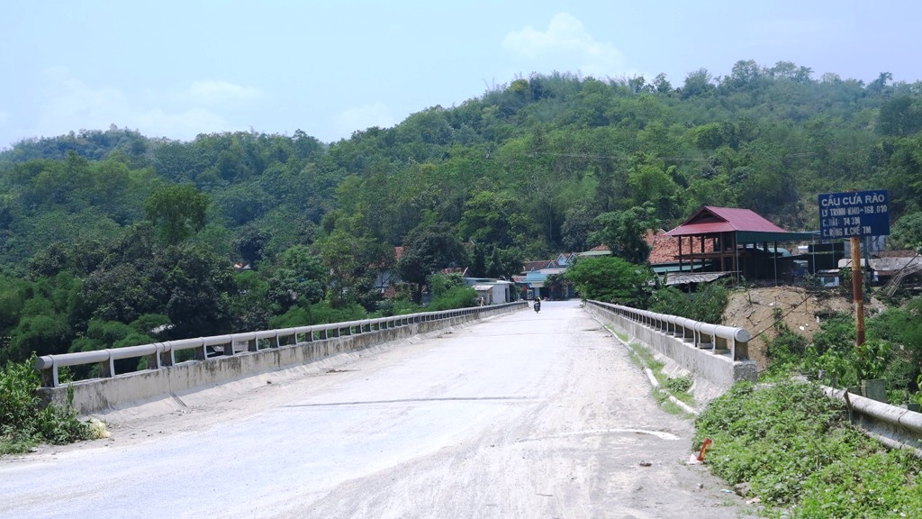
- The hottest place in Viet Nam is Cua Rao, in Tuong Duong, Nghe An
Weather
(Average temperature in summer: 40°C
Sometimes: 44°C-45°C)

Slide 39

3. What’s the coolest place in Viet Nam?
Weather

Slide 40
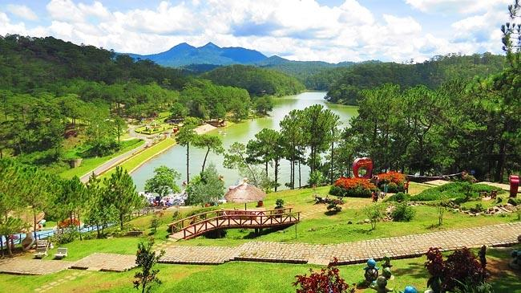
- The coolest place in Viet Nam is Da Lat City in Lam Dong highland.
Weather
(Cool all year round.
Average temperature: 18°C -20°C)

Slide 41

4. What’s the coldest place in Viet Nam?
Weather

Slide 42
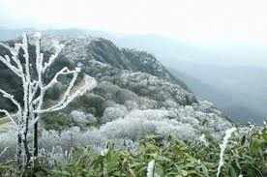
The coldest place in Viet Nam is Mau Son mountain in Loc Binh, Lang Son
Weather
(Average temperature in winter: below 10°C
Sometimes: below 2°C)
.

Slide 43

Thank you for listening

Slide 45
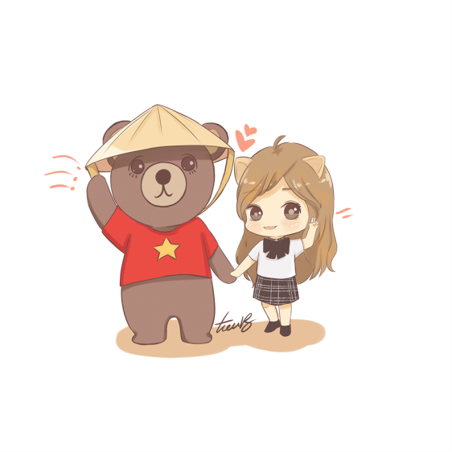
Welcome to Viet Nam
Tour guides: Mỹ Linh, Ngọc Minh, Thư, Phương,
Tuấn Nghĩa, Tâm Anh

Slide 46

TRAVELLING
1. What’s/nice/city in Viet Nam?
2. What’s/good/ place for tourists to come?
3. What’s/convenient/ time of the year to visit?
4. What’s/fast/ way to travel around Viet Nam?

Slide 47
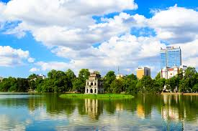
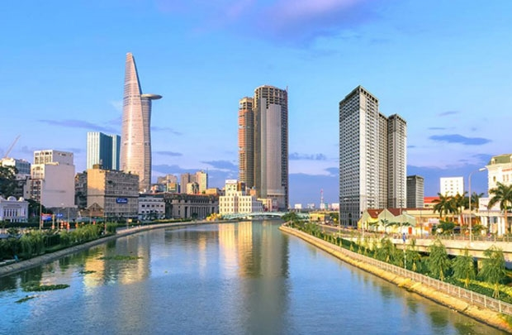
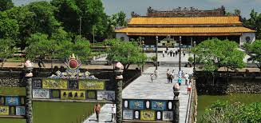
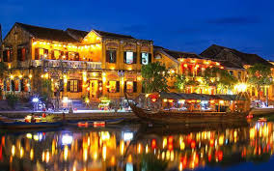
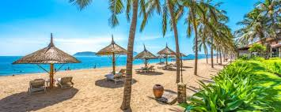
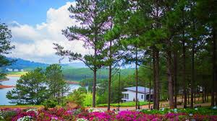
The nicest cities in Viet Nam

Slide 48
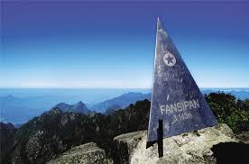
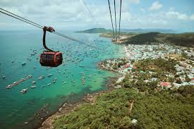
The best places for tourists to come

Slide 49

The most convenient time of the year to visit

Slide 50
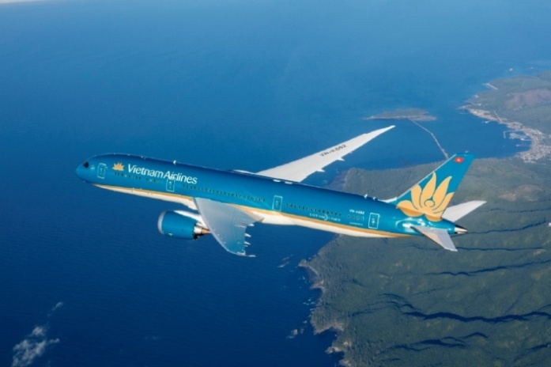
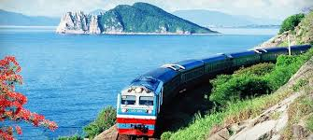
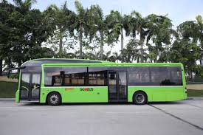
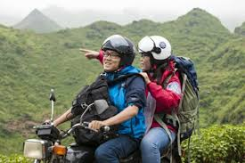
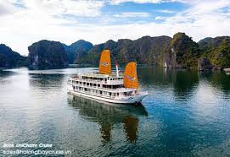
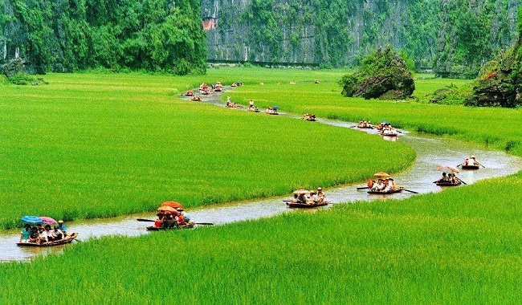
The fastest ways to travel around Viet Nam?

Slide 51



Slide 52
How well do you know about Viet Nam?
Information
Excellent/good/fine/not very good
Communication and interaction
Excellent/good/fine/not very good
Vocabulary and grammar
Excellent/good/fine/not very good

Slide 53
COMPLETE YOUR SELF-ASSESSMENT
Finished! Now you can… | √ | √ √ | √ √ √
name natural things and travel items
use superlative adjectives to describe the world around you
give orders and advice using “must” and “mustn’t”

Slide 54
HOMEWORK
1. Write down what you know about Viet Nam (weather, natural wonders, travelling...)
2. Prepare for unit 6 ( Getting started).

Slide 56
Thank you for listening

Slide 57
How well do you know about Viet Nam?
Natural
Information given
Excellent/good/fine/not very good
Communication and interaction
Excellent/good/fine/not very good
Vocabulary and grammar
Excellent/good/fine/not very good

